Slide 1




Publishing and Consuming Geo-spatial and Government Data on the Semantic Web
Ghislain Auguste Atemezing
Multimedia Department, Eurecom
Supervisor:
Dr. Raphaël Troncy, MM Department, Eurecom

Slide 2
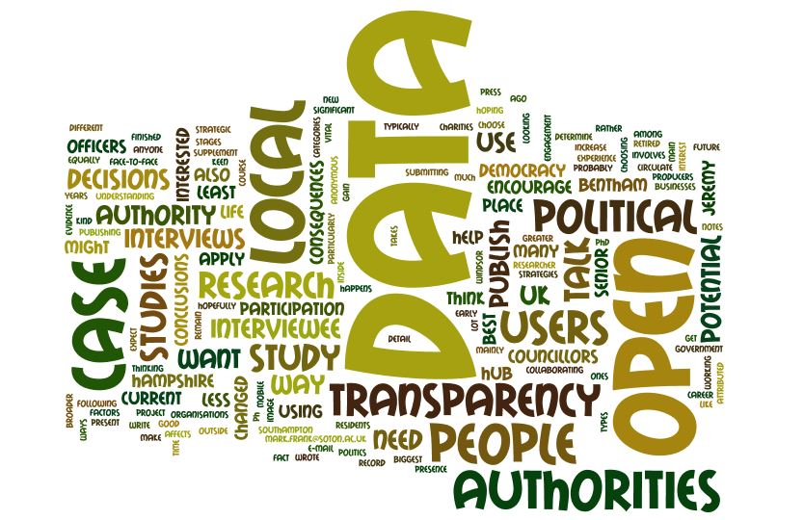


Thesis Context
Open Government Data benefits
Transparency in decision making
Better governance or e-governance
Eco-system of added value application
Barriers and challenges
Heterogeneity of data formats
Variety of access method
Lack of nomenclature
In this thesis we explore how Semantic Web technologies can be used for better integration and consumption of geo-spatial data.
Notes:
Over the past few years, the domain of Open Data has received an increasing attention from public administrations. Potential benefits for citizens include more transparency in the decision making, a better governance and a virtuous development of a digital eco-system that would create added-value apps when processing and analyzing open data.
However, opening up and publishing data is not enough to create this data value chain due to a number of challenges such as the heterogeneity of formats (XML, CSV, Excel, PDF, Shape Files), the variety of access methods (API, database, dump) and the lack of nomenclature that would enable to better re-use and interconnect datasets.
In this thesis, we explore how semantic web technologies can be used to tackle the research problems related to the integration and consumption of geo-spatial data.

Slide 3
Outline
Introduction
Research Questions
Contributions
Semantic publishing of geospatial data
Visualizations of Government Linked Data
Best Practices for metadata in vocabularies
Conclusion
Publications

Slide 4
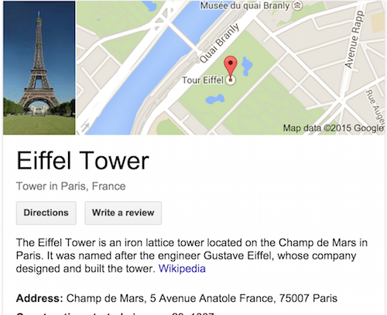

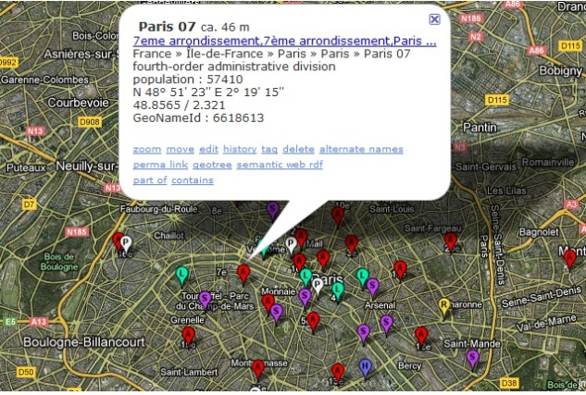
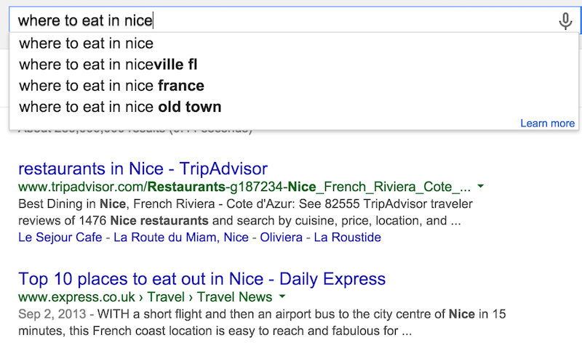

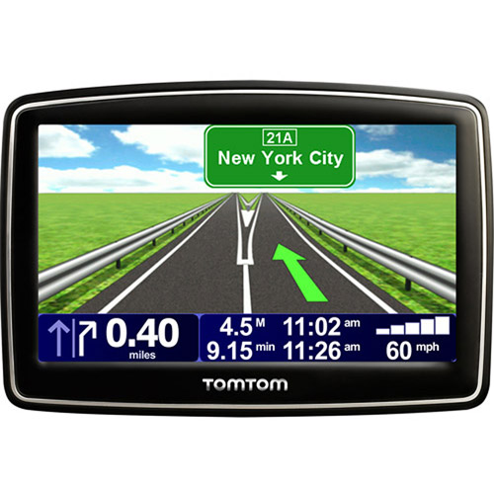
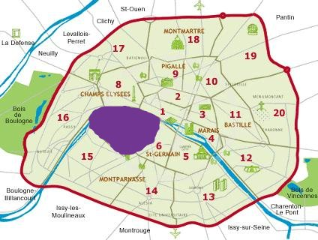
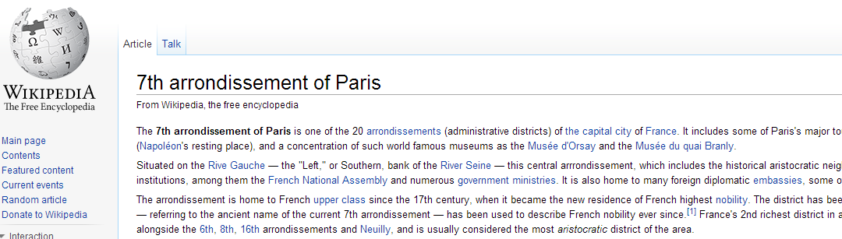
Geospatial data: why it matters
“80% of needs for decisions from public authorities have a geospatial component”.
(Philippe Grelot, IGN-France)
Notes:
+ mobile applications are good examples of using geolocation

Slide 5
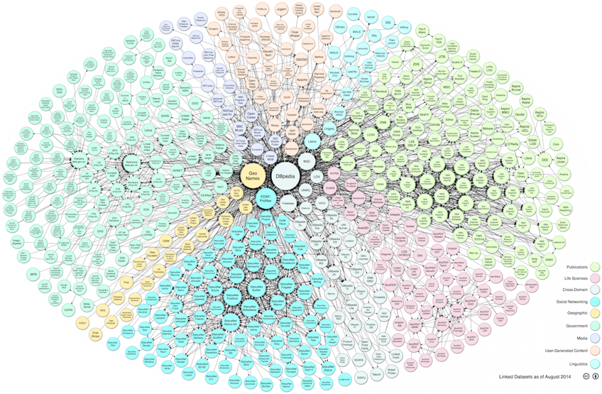
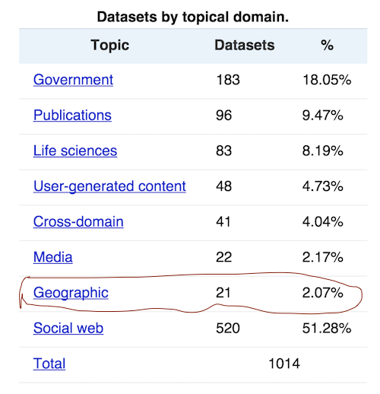
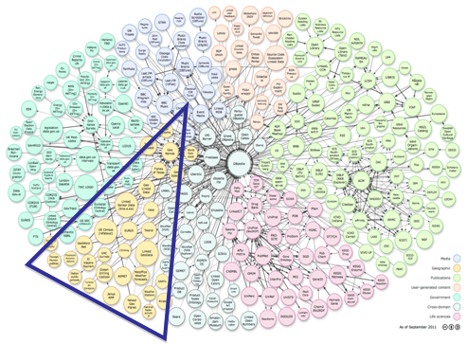
GeoData on the LOD Cloud
http://lod-cloud.net/versions/2014-08-30/
Linking Open Data cloud diagram 2014, by Max Schmachtenberg, Christian Bizer,
Anja Jentzsch and Richard Cyganiak.
http://lod-cloud.net/
In 2011 19,43% →31 geo-datasets in LOD
http://lod-cloud.net/state/

Slide 6
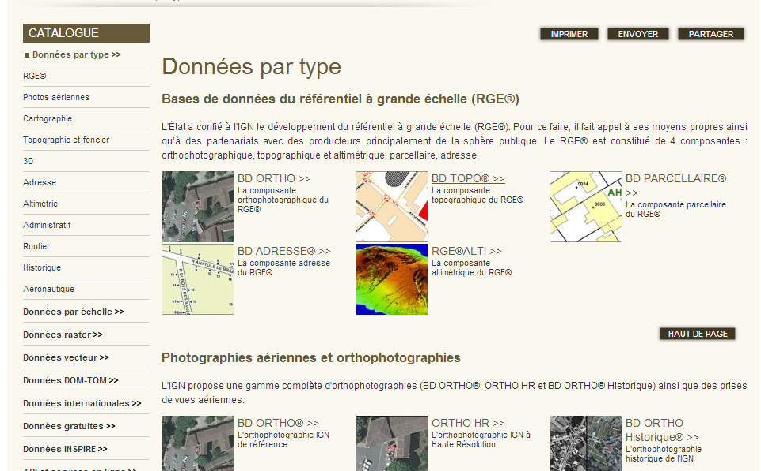
French IGN- Reference Geodata
« ..describes the French national territory and the occupation of its land, elaborates and updates perpetual inventory of the forest resources »
Different databases with overlapping information: BD ORTHO, BD PARCELLAIRE, POINT ADRESSE, BD ALTI 25m, BD TOPO; etc.
CRS: LAMBERT93 or RGF93
Q: ”Give me all the bridges in a radius of 2km from the "Eiffel Tower“?
A: Not straightforward
Notes:
Files available in SHP, pdf
Information overlap in different products, sometimes referring to the same « real world » concepts.

Slide 7
Research Questions
How to efficiently represent and store geospatial data on the Web to ensure interoperable applications?
the publication of real datasets
the interlinking with other datasets having overlapping coverage
What are the best options for a user to discover, browse and interact with semantic content?
Can we propose a generic model for visualizing semantic content?
What are the mechanisms to help preserving structured data of a high quality on the Web?
How to improve reusing vocabularies for better interoperability
How to detect incompatibility between data and metadata
2015/04/10
Notes:
+ Talk here about the research questions + spend more time here…

Slide 8
Part 1
Semantic Publication of
Geo-spatial Data
2015/04/10

Slide 9
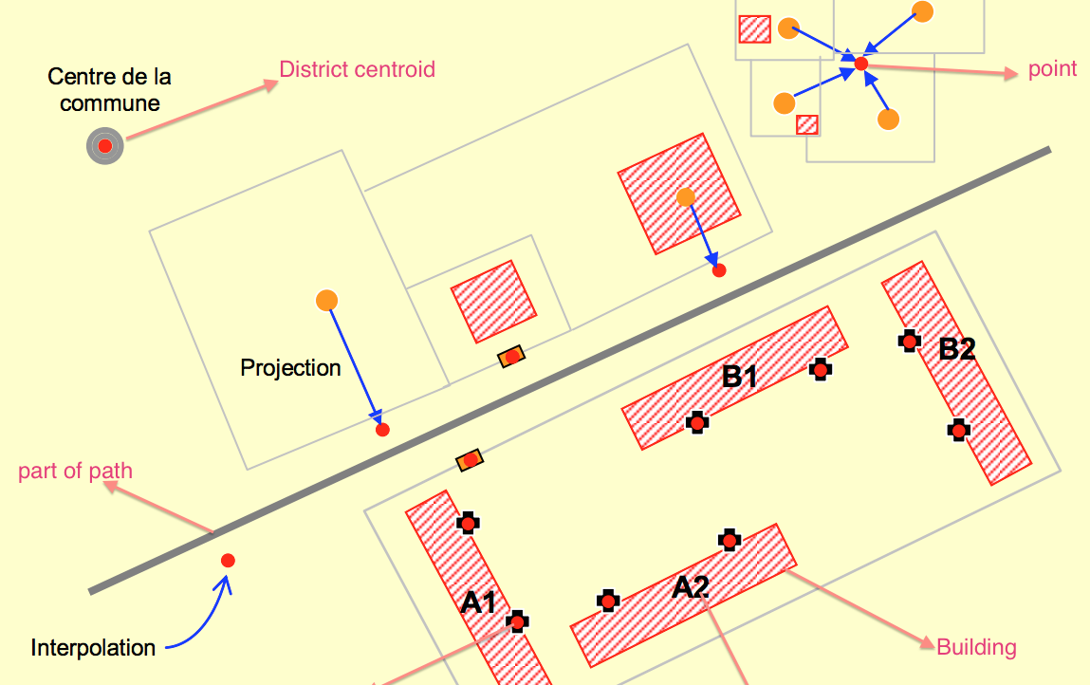
Modeling geospatial objects
3 main components:
CRS
Features
Geometry
2015/04/10

Slide 10
Coordinate Reference Systems (CRS)
A representation of the locations of geographic features within a common geographic framework
Each CRS is defined by its measurement framework
Geographic: spherical coordinates (unit: decimal degrees)
Planimetric: 2D planar surface (unit: meters) + a map projection
Additional measurement properties: ellipsoid, datum, standard parallels, central meridians, etc.
Situation:
Several hundred Geographical Coordinate Systems (WGS84, ETRS89, etc.)
Several thousands Projected Coordinate Systems (UTM, Lambert93, etc.), http://resources.esri.com/help/9.3/arcgisserver/apis/rest/pcs.html
2015/04/10
Notes:
Clearly explain what is the framework.

Slide 11
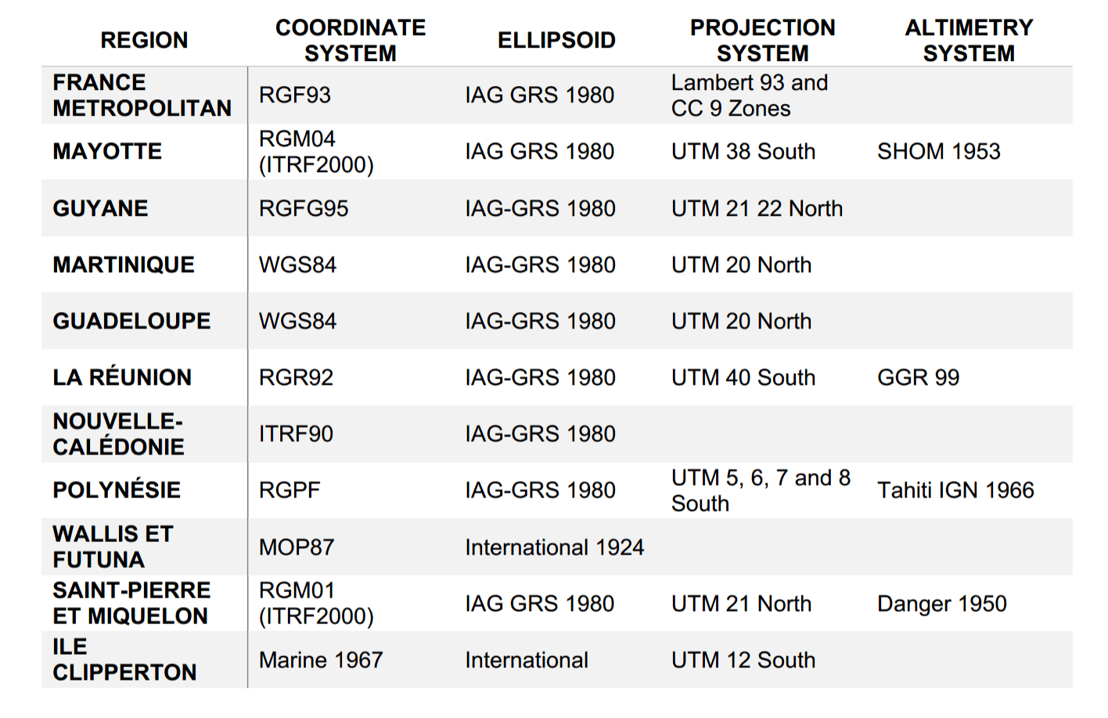
CRS in France (Metropolitan + overseas)
10 CRSs coverage (mostly RGF93)
10 projections (mostly used Lambert93)
3 different ellipsoids to define the CRS
The Web only used WGS84
Publishers need converters for their geodata
2015/04/10
Notes:
+ The framework is the ellipsoid used to define the CRS

Slide 12
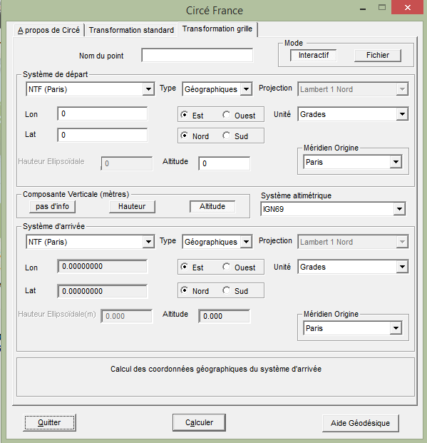
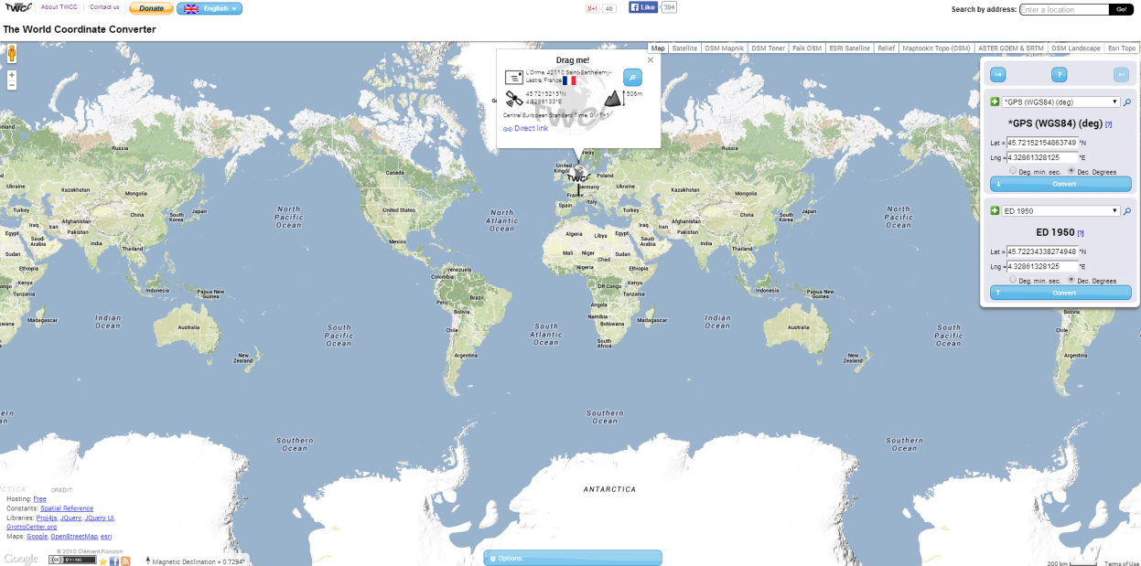
CRS Converters and Limitations
Circé: A Converter Software from IGN
Allows conversion between some France CRSs to WGS84
Closed Source, No open service
Existing Web tools (e.g., world coordinate converter)
No open service, closed source
Converting algorithms don’t usually map to any national mapping authority.
Contribution: a Web based service to perform conversion between various CRSs.
The integration of such a converter can ease the process of the publishing different types of geometries on the web regardless of their Coordinates systems.
2015/04/10

Slide 13
Developing a REST converter service
International Communication
Many regional's’ published data involve with local CRS
A medium
Interpret the coordinates between these CRSs
A Converter Service
Open services for community
RESTFul Web Service
WGS 84 <–> Lambert 93
WGS 84 <–> UTM
GOOD accuracy of the results
2015/04/10
Notes:
+ check the link of the REST service.

Slide 14
Vocabularies for Modeling Features
Authority list of terms (e.g. Foursquare)
No semantics at all!
SKOS Categories (e.g. GeoNames)
Classes are skos:conceptScheme, codes are skos:Concept
Domain specific ontologies (OrdS, GeoLD)
Interconnected subdomain ontologies (transport,
hydrography, etc.)
Data driven ontologies (LGD, GeOnto)
Deeper taxonomy to structure the ontology
Many classes
2015/04/10
Notes:
+ Explain where the LGD ontology developed in LGD project.
+ GeoOnto comes from a French Project, Pr. Reynauld

Slide 15
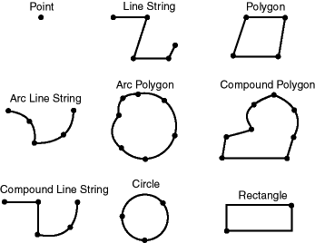
Modeling Geometry: State of the Art
Point (lat/long)
WGS 84 vocabulary described by W3C
Rectangle (“bounding box”)
Geopolitical Vocabulary (FAO)
Points in a List
Sequence of points (LinkedGeoData)
An object is “formedBy” a ListOfPoints (GeoLinkedData.es)
Literals WKT datatype in RDF
Ordnance Survey (UK), GeoSPARQL embedding CRS in literals
More structured representation of complex geometry
NeoGeo Vocabulary (GeoVocamp), http://geovocab.org/
2015/04/10
Notes:
Five approaches for modeling the Geometry: Point, Rectangle, Points in a List, Points in a group of RDF resources, Literals and more structured
+ Explain more: A geometry as just a Point. A bounding box, Add where GeoSPARQL comes into play

Slide 16
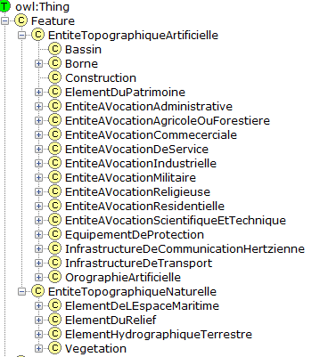
Reusing Existing Ontologies (GeOnto)
Ontology for geographic objects (POI)
Output of a French (ANR) research project
Obtained from NLP tools
Classes in French
rdfs:labels in FR & EN
No rdfs:comments
Few owl:ObjectProperty
783 classes
Overlap with other vocabs
Need for alignment
2015/04/10

Slide 17
Aligning GeOnto with existing Ontologies
Alignment of GeOnto with 5 ontologies and 2 simple taxonomies
LGD, DBpedia, Schema.org, GeoNames, bdtopo
Foursquare, Google Places
Goal: finding owl:equivalentClass
Tool : Silk framework
Metrics : LevenshteinDistance, Jaro
Labels : @en des classes
Aggregation Function: Mean
Manual validation
For « rdfs:subClassOf »
Specific alignments with GeoNames codes
2015/04/10

Slide 18
Alignment Process (GeoNames)– Results
Vocab/taxonomies | #Classes | #Classes aligned
Bdtopo | 237 | 153 (64.65%)
GeoNames | 699 | 287 (41.06%)
Google Place (*) | 126 | 41 (32.54%)
Schema.org (*) | 296 | 52 (17.57%)
LGD | 1294 | 178 (13.76%)
Foursquare | 359 | 46 (12.81%)
DBpedia | 366 | 42 (11.48%)
Silk
Look for skos codes that matches GeOnto classes
Verify the links <70%
SPARL Endpoint
Use SPARQL «Construct» to generate a new graph.
Alignment File
Export the RDF file
Generate « sameAs » links
High precisions > 80%
BUT P(Schema.org) = 50%
GeOnto entities are more specific to France
2015/04/10
Notes:
Bdtopo will be the basic for the topo ontology.
+ Schema.org (shows version) and DBPedia (version). See the result of precision.
+ Now Schema.org contains 1500+ terms.

Slide 19
Proposal: CheckList for modeling geodata
Complex Geometry Coverage
Need to publish more data with complex geometries
Reuse and extend suitable ontologies (NeoGeo, GeoSPARQL)
Features MUST be connected to Geometry
Sometimes it may requires two namespaces
Serialization in other GIS formats
Provide serialization in other GIS formats (GML, WKT, KML, etc.)
Structured Representation
Use of structured representation for complex geometry
This covers some of the Use Cases at IGN
2015/04/10

Slide 20
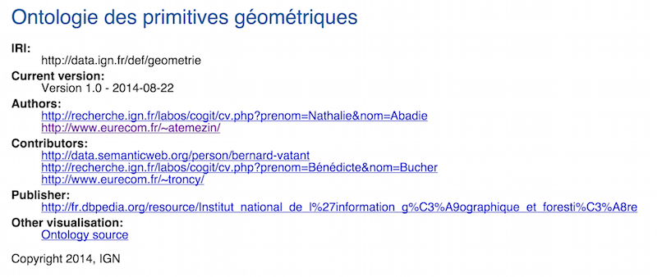
Proposal: Vocabulary for complex Geometry
Extend and reuse existing vocabularies
Available at http://data.ignf.fr/def/geometrie
@prefix ngeo: <http://geovocab.org/geometry#>.
@prefix sf: <http://www.opengis.net/ont/sf#>.
[…]
geom:Geometry a owl:Class;
rdfs:comment "Primitive géométrique non instanciable, racine de l'ontologie des primitives géométriques. Une géométrie est associée à un système de coordonnées et un seul."@fr;
rdfs:label "Géométrie"@fr, "Geometry"@en;
owl:equivalentClass [ a owl:Restriction;
owl:onClass ignf:CoordinatesSystem;
owl:onProperty geom:crs;
owl:qualifiedCardinality "1"^^xsd:nonNegativeInteger];
rdfs:subClassOf ngeo:Geometry;
rdfs:subClassOf sf:Geometry.
2015/04/10

Slide 21
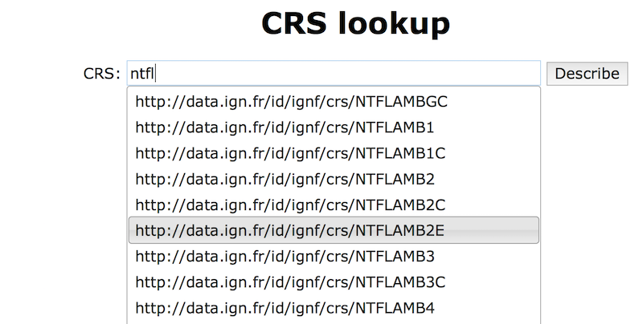
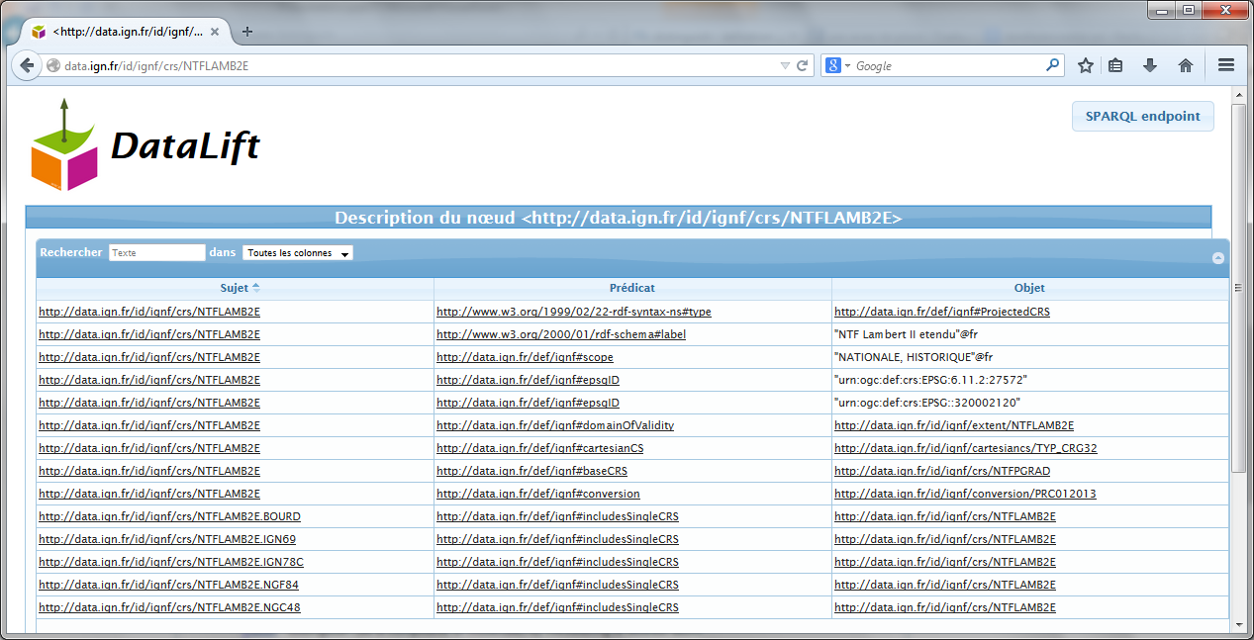
Associating CRS to Geometries
A vocabulary for describing CRS
Subset of ISO 19111 model
Available at http://data.ignf.fr/def/ingf
A dataset for French CRS
Convert from XML data published by IGN France to RDF
Eg: “Lambert 2 étendu” http://data.ign.fr/id/ignf/crs/NTFLAMB2E
2015/04/10

Slide 22
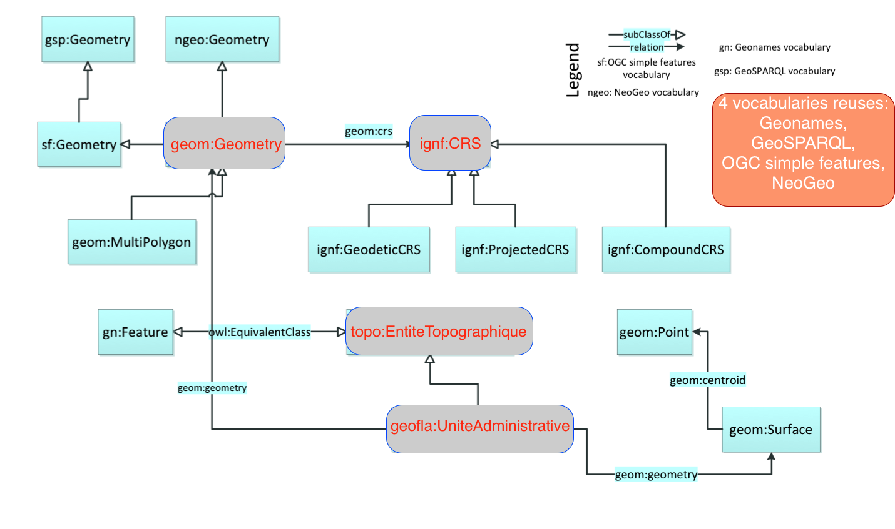
Overview of the vocabularies and relationships
2015/04/10
Notes:
Big picture of the relationships among the different vocabularies designed and implemented (geom for geometry, ignf for CRS, topo for topographic entities, geofla for administrative units.
Prepare transition for the workflow for using the vocabularies in transforming datasets in 4 -5 stars using Datalift.

Slide 23
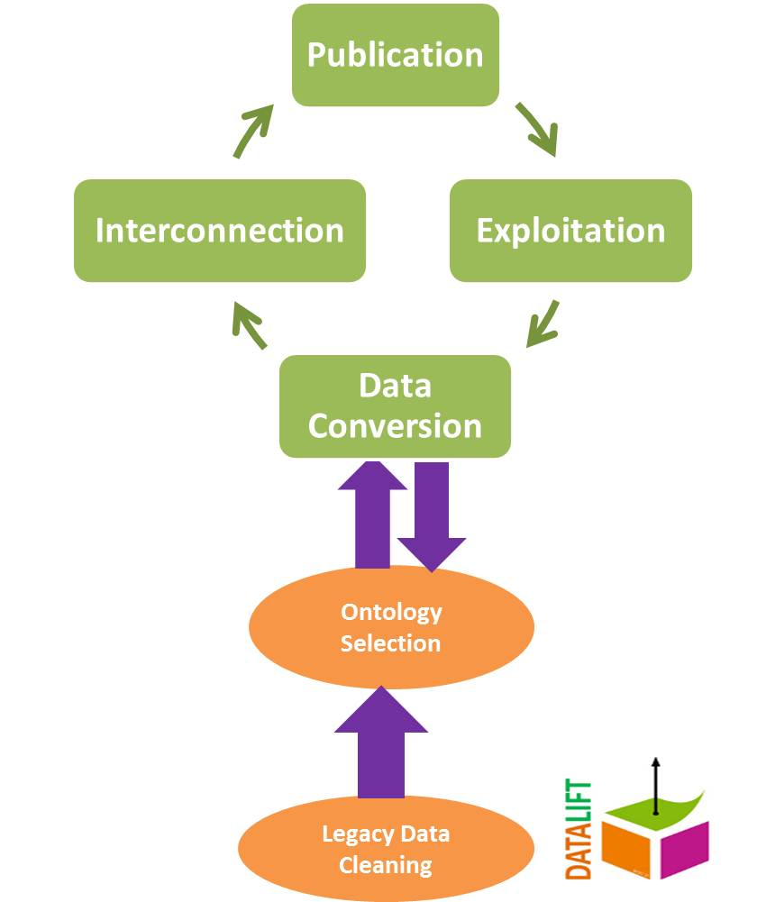
A workflow for publishing Linked(Geo)Data
Datalift: a set of modular tools for “lifting” raw data in RDF.
2015/04/10
Notes:
+ Datalift provides with a module for converting Shape files into RDF using geom, ignf; implemented at IGN.

Slide 24
Publishing French Reference Geodata in RDF
GEOFLA® Dataset on French administrative units in rdf
Features are of type http://data.ign.fr/geofla
French gazetteer dataset
Features are of type http://data.ign.fr/topo
Mapping results with external dataset
DATASET GEOFLA DATASET |  | #mappings | Tool
 | INSEE | 37,020 | SILK
 | DBPEDIA-FR | 23, 252 (communes) and 93 departments | LIMES
 | NUTS | 105 links (14 comm., 75 depts, 16 regions) | SILK
 | GADM | 70 links (10 comm., 51 depts, 9 regions) | SILK
FRENCH GAZETTEER | LINKED GEODATA | 654 links (lgdo:Amenity) | LIMES
2015/04/10
Notes:
+ I’ve tested different configurations of the scripts.
+ I’ve used manual assessment
+ LIMES vs SILK: Dataset bigger: scalability issues ..much better or use of Haussdorf function.
+ 8 classes of lgd:Amenity

Slide 25
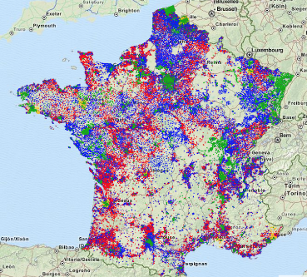
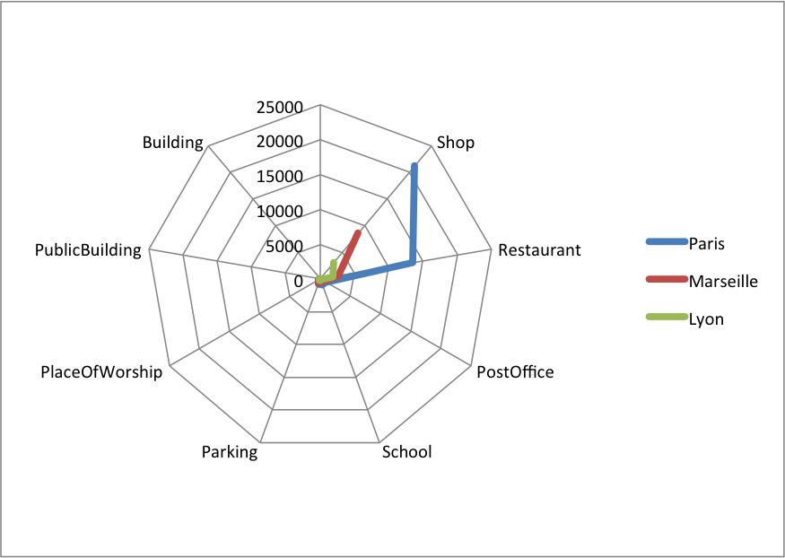
French Open Addresses in RDF Mappings
LGData Amenities | Paris (248052) |  | Marseille (401404) |  | Lyon (89061)
 | #matched | %matched | #matched | %matched | #matched | %matched
Shop (778680) | 21171 | 2.71 | 8556 | 1.098 | 3049 | 0.391
Restaurant (260675) | 13567 | 5.204 | 2654 | 1.018 | 1882 | 0.721
PostOffice (87731) | 971 | 1.106 | 555 | 0.632 | 173 | 0.197
School (318287) | 883 | 0.277 | 411 | 0.129 | 197 | 0.061
Parking (250516) | 735 | 0.293 | 625 | 0.24 | 210 | 0.083
PlaceOfWorship (357445) | 272 | 0.076 | 193 | 0.053 | 31 | 0.008
PublicBuilding (26735) | 97 | 0.362 | 64 | 0.239 | 21 | 0.078
Building (22283) | 5 | 0.022 | 12 | 0.053 | 0 | 0
BANO2RDF
2015/04/10

Slide 26
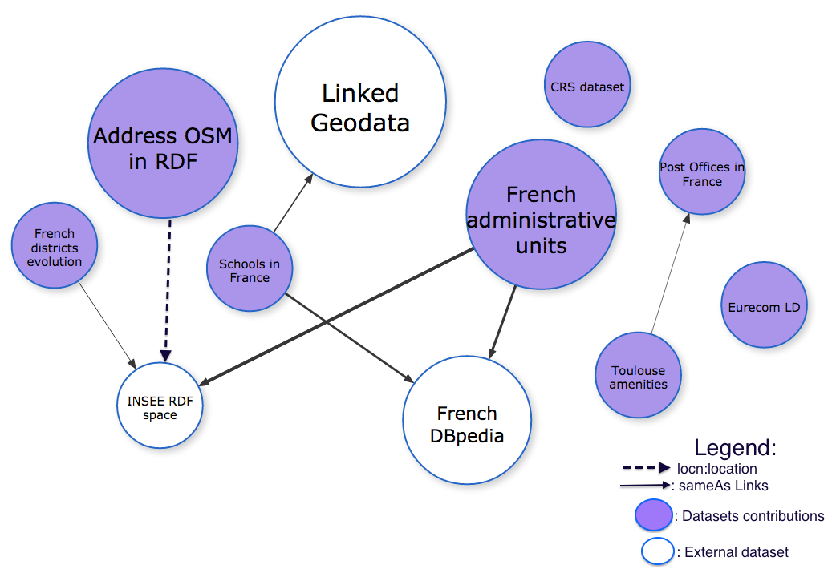

Contribution to the LOD Cloud (FrLOD)
340 millions of triples in RDF (10% of DBPedia 2014)
Part of our work is under reused by the W3C/OGC Spatial Data Working Group
2015/04/10
Notes:
Explain here that it’s not enough to have RDF data. Users need a means to visualize the triples.
Prepare transition for the visualization section (types of visualizations, the DVIA model and LDVizWiz)
Spend more time here…

Slide 27

Why Visualizations Matters
“Don’t ask what you can do for
the Semantic Web; ask what
The Semantic Web can do for you!”
(D. Karger, MIT CSAIL)
“If you use our Linked Data, please let us know, or we might switch off!”
(Ordnance Survey)
How to build bridge to fill the gap between traditional InfoVis tools and Semantic Web technologies
How can Semantic Web help in visualization?
2015/04/10

Slide 28
Part 2
Generating Visualizations For Linked Data
2015/04/10

Slide 29
Visualization Categories in Government Portals
Study of applications consuming Open Data
13 applications from UK (7), USA (3) and France (3)
Domain: education, health, transport, government, city, housing, criminality, foreign aid
Different dimensions
Platform (web, mobile), data sources, which views are available (maps, charts, timeline, etc.)
URL policy for identifying data objects
Licenses for the application / for the data
Commercial / non-commercial
2015/04/10

Slide 30
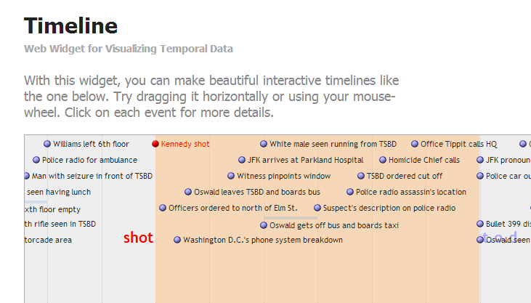
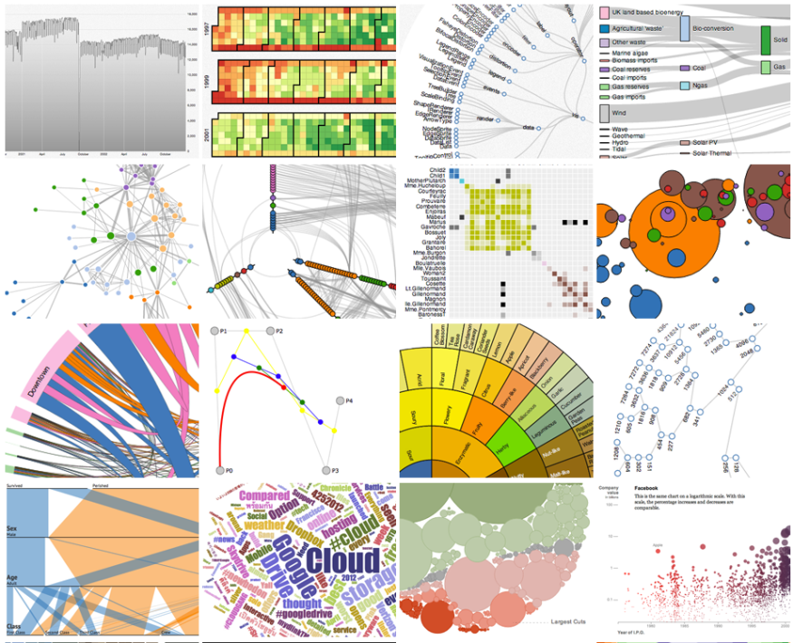
Relevant Features in Visualization Tools
Data format given as input (csv, xml, shp, rdf, etc.)
Data access (API, dump, etc.)
Language code
Type of view
External Libraries
License
Metadata: author, organization
2015/04/10
Notes:
Importance of each feature:
* Data formats: the type of the format could lead to the decision of creating a converter layer before the visualization layer.
Data access: defines how to get the data, such as simple dump, API, SPARQL endpoint
Language code: this helps deciding also for the integration of tool.
Type of view is essential depending on the type of the data to display. E.g: if the tool does not provide timeline view, it could be difficult to want to create a visualization making use of timeline.
* External libraries are useful for integration compatibility.
* License for reusability of the tool
* Author/creator for metadata mention of the owner or the tool

Slide 31
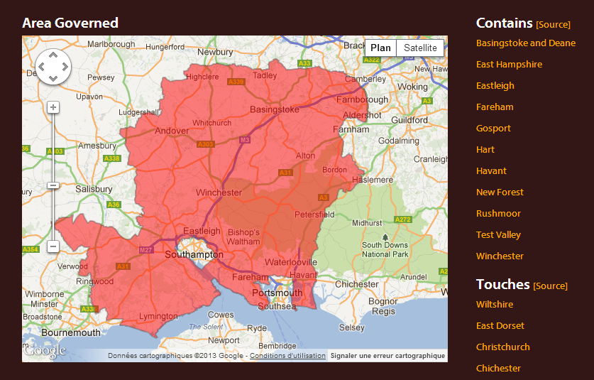
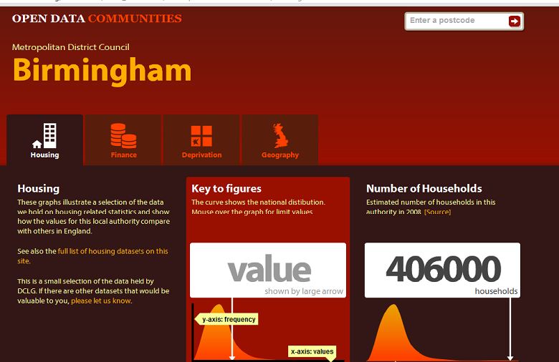
Describing an Application: Opendatacom
Scope/Domain: Department for Communities and Local Government, datasets access
Description: visualize available datasets (finance, housing, deprivation, geography) by authorities or postcode.
On the dashboard, it provides graphs showing the national distribution of a district and how the values for this local authority compare with others in England.
Supported Platform: Web
URL Policy: http://{domain}/id/{...} with redirection to the corresponding document at: http://{domain}/doc/{...}.
Hampshire County Council is: http://opendatacommunities.org/id/county-council/hampshire
Data Sources: 36 datasets from DCLG, Administrative Geography and Postcodes from Ordnance Survey.
Type of View: Graph, Map views.
Visualization Tools: google visualization API, raphael.js
License: Open Government license [OGL]
Business Value: Non commercial
2015/04/10

Slide 32
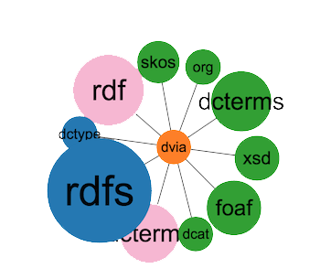
DVIA: A vocabulary to describe Applications
dctype:Software
Prefixes:
@prefix dct: <http://purl.org/dc/terms/>.
@prefix dcat: <http://www.w3.org/ns/dcat#>.
@prefix dctype: <http://purl.org/dc/dcmitype/>.
@prefix org: <http://www.w3.org/ns/org#>.
@prefix dvia: <http://data.eurecom.fr/ontology/dvia#>.
dvia: Application
dvia: Platform
org:Organization
dct:title
dvia:description
dvia:keyword
dvia:url
dct:creator
dvia:businessValue
dvia:scope
dvia:view
dct:title
dvia:system
dvia:preferredNavigator
dvia:alternativeNavigator
dvia:designBy
dvia:platform
dvia:usesTool
dvia:consumes
dcat: Dataset
dvia: VisualTool
dct: title
dcat: accessURL
dct:references
dcat: keyword
dct:title
dct:description
dvia:accessUrl
dvia: downloadUrl
2015/04/10

Slide 33

DVIA in Real World Datasets
4 applications re-using DVIA
Use to populate 22 past events of hack-athons in Europe, with 889 applications from Apps4Europe.
Implementation of a universal JavaScript plugin to embed RDFa in organizers events
An extension for Wordpress uses DVIA.
2015/04/10

Slide 34
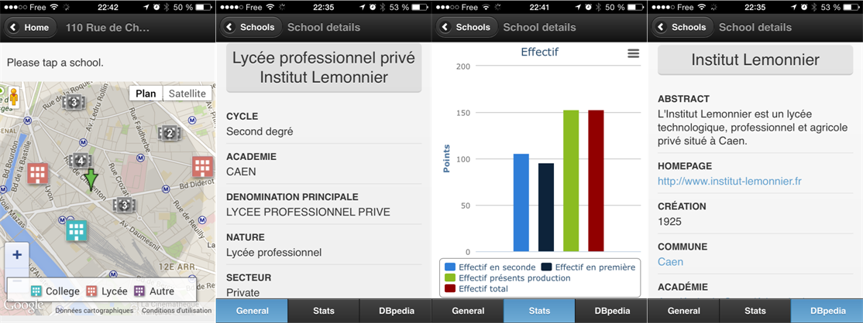
Developing Web Applications: from specific to generic approach
Scenario 1
Known Datasets, Known vocabularies → Specific SPARQL queries
Visualizations: dataset specific
Example
Datasets on schools in France
Vocabularies: geo vocab, data cube, geometrie,
Application: PerfectSchool
2015/04/10

Slide 35
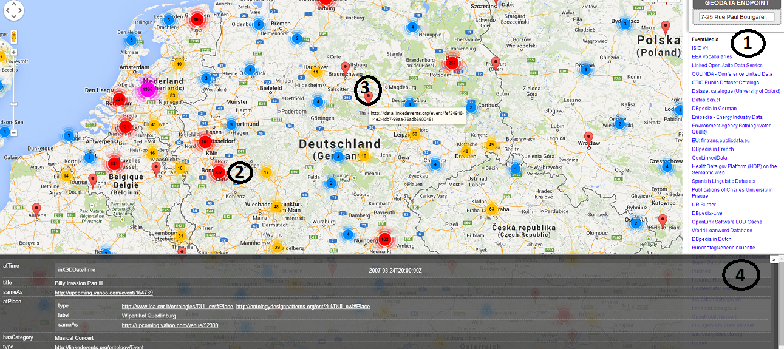
Developing Web Applications: from specific to generic approach
Scenario 2
Unknown Datasets, Known domains, so domain-specific SPARQL queries
Visualizations: domain specific
Example
Endpoints of geodatasets
Domain: geospatial
Application: GeoRDFviz
2015/04/10

Slide 36

Developing Web Applications: from specific to generic approach
Scenario 3
Unknown Datasets, Unknown domains, so generic SPARQL queries
Visualizations: adapted to domains specific
Any endpoints
Multiple domains: geodata, statistics, persons, cross-domains, etc..
Application: ?????
Related work on configuring Semantic Web widgets by data mapping. [1]
Application: Efficient search for Semantic News demonstrator
in Cultural Heritage Dataset
Tool: ClioPatria
…but “method not apply to create
interfaces on top of arbitrary
SPARLQ endpoints”
[1] Hildebrand, Michiel, and Jacco Van Ossenbruggen. "Configuring semantic web interfaces by data mapping."
Visual Interfaces to the Social and the Semantic Web (VISSW 2009) 443 (2009): 96.
2015/04/10

Slide 37
Our Proposal
Linked Data
Vizualization Wizard
(LDVizWiz)
2015/04/10

Slide 38
Requirements of LDVizWiz (LDViz-”Wise”)
Predefined categories associated to visual elements
Build on top of RDF standards
e.g., SPARQL queries ; Semantic Web technologies
Reuse existing Visualization libraries
e.g., Google Maps, Google Charts, D3.js, etc.
Reuse On-line Library of Information Visualization (OLIVE)
Target to non “RDF/SPARQL speakers”
Input: Datasets published as LOD
2015/04/10

Slide 39
Mapping Categories and vocabularies
Geographic information
geo: vocab, schema:Place, etc.
Temporal information
Time, interval ontologies
Event information
lode, event, sport, etc..
Agent/Person
foaf:Person/foaf:Agent
Organization information
ORG vocabulary, foaf:Organization
Statistics information
Data cube, SDMX model
Knowledge information
Schemas, classifications using SKOS vocabulary
2015/04/10

Slide 40
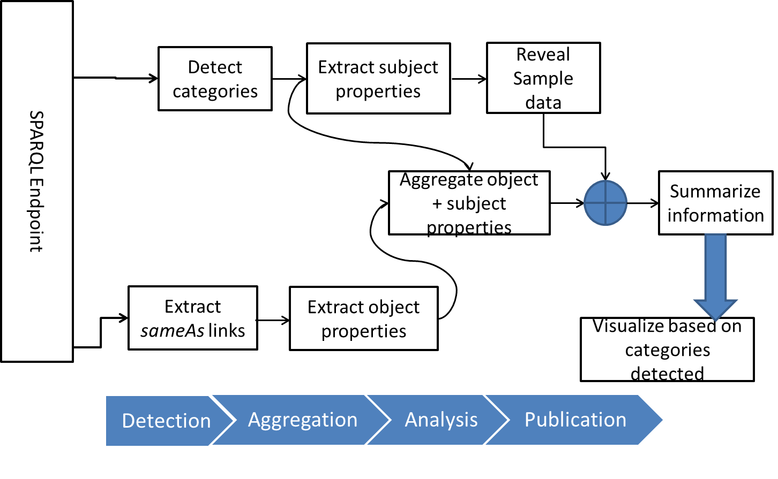
LDVizWiz Workflow
2015/04/10

Slide 41
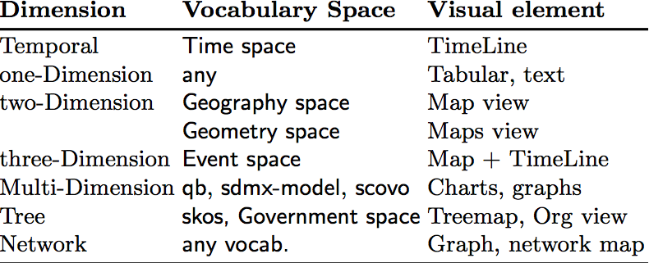

Step 1: Categories Detection
Detection of main categories in datasets
ASK SPARQL queries on predefined categories
Uses well-known vocabularies in LOV
Condition the type of visual elements
Detection
2015/04/10

Slide 42
Experiment: Categories Detection
Category | Number | %
GEO DATA | 97 | 21.84%
EVENT DATA | 16 | 3.60%
TIME DATA | 27 | 6.08%
SKOS DATA | 02 | 0.45%
ORG DATA | 48 | 10.81%
PERSON DATA | 59 | 13.28%
STAT DATA | 29 | 6.6%
Applications
Automatic detection of endpoints categories
More “trustable” than human tagging
Map categories detected with “suitable” visual elements for the visualizations (e.g., TimeLine + maps for events data)
444 endpoints (*) analyzed, 278 good answers (62.61%) using ASK queries.
Few taxonomies in SKOS, many GEO DATA
Detection
(*) All the endpoints retrieved from sparqles.org
2015/04/10
Notes:
+ Add the date of endpoints

Slide 43
Step 2: Properties Aggregation
Goal: Exploit the “connectors” between graphs
“connectors” are used to enrich a given graph
e.g., owl:sameAs ; rdfs:seeAlso, skos:exactMatch
Retrieve properties from external datasets
So called “enriched properties”
Build candidate properties for visualization
For pop-up menus
For facet browsing
For charts display
Detection
Aggregation
2015/04/10

Slide 44
Step 3: Publication
Visualization Generator
Recommend the visual elements based on categories
Transform ASK queries to SELECT or CONSTRUCT queries for input to visual library.
Visualization Publisher
Export the description of visualization in RDF
Add metadata for the visualization (charts) and steps used to create it.
e.g., dcat:Dataset, prov:wasDerivedFrom, chart vocabulary, void:ExampleResource.
Detection
Aggregation
Publication
2015/04/10

Slide 45
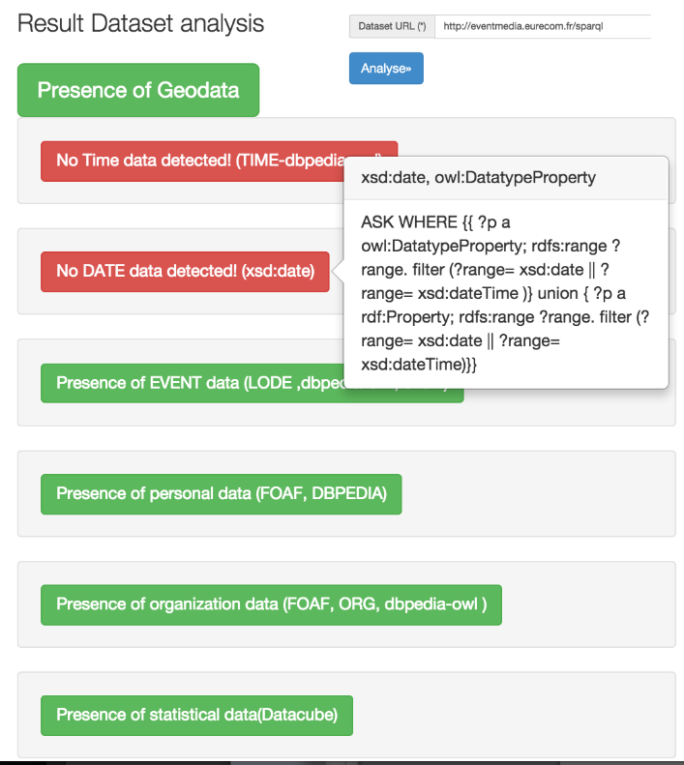
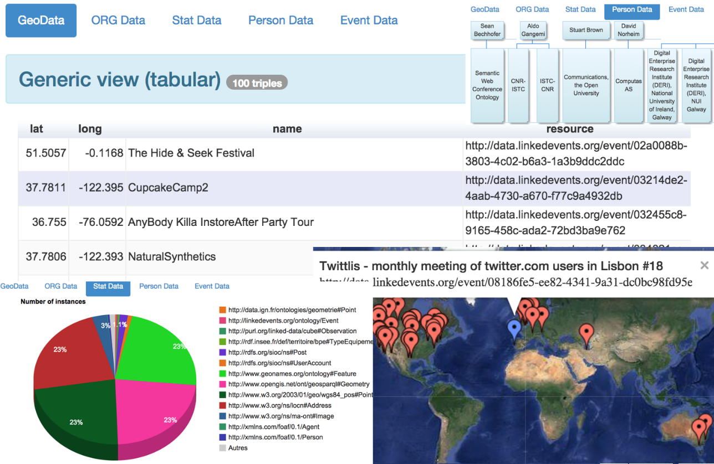
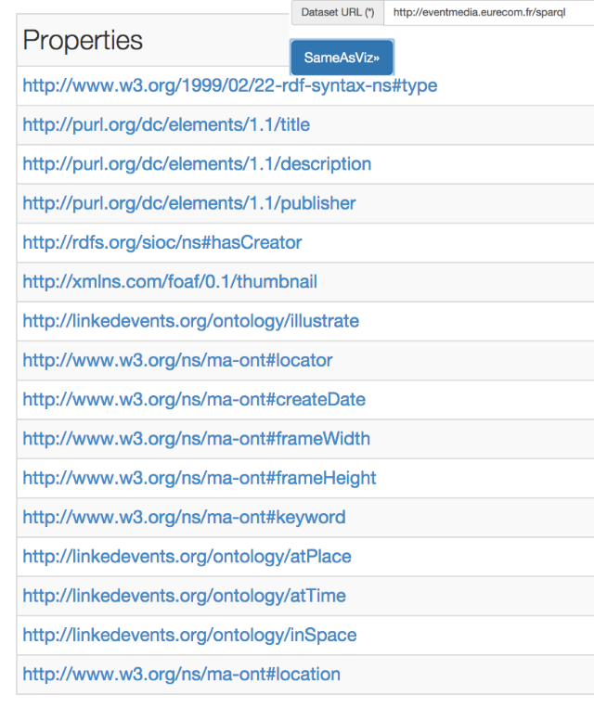
Current Implementation
Javascript light version as “proof-of-concept”
Url: http://semantics.eurecom.fr/datalift/rdfViz/apps/
2015/04/10

Slide 46
Part 3
Best Practices for metadata in vocabularies
2015/04/10
Notes:
Metadata helps for better controling and discovering data published within a scope/context.

Slide 47

W3C Govn’t LD Best Practices
10 best practices to help government worldwide to access and reuse their by taking benefit of Linked Data mechanism.
4 steps to rich 5★ ratings datasets in TimBL scale.
2015/04/10
Notes:
We have actively participated in this Working Group and we are an editor of a working group note that list those best practice.

Slide 48



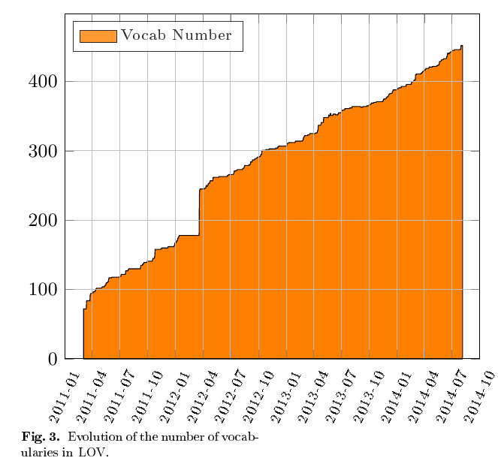
LOV in a Nutshell : http://lov.okfn.org/dataset/lov/
A curated list of vocabularies
More than 495 vocabularies
Each of them described by vocabulary-of-a-friend (voaf)
Provide a dump in N3 of the different versions of a vocabulary
Quasi linearity of the growth, started with 75 vocabularies
The glitch in 2012 corresponds to the migration to OKFN hosting
2015/04/10

Slide 49
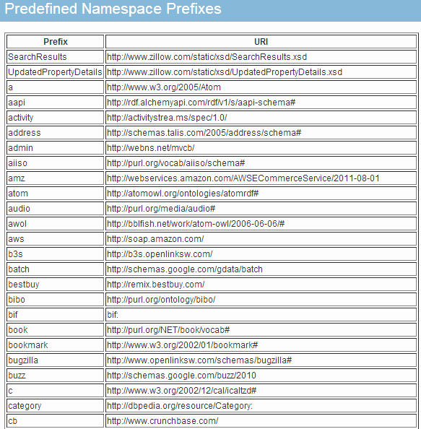
Focus on vocabularies: Disambiguating Vocabulary Prefixes
Goal:
align services against Linked Open Vocabularies to harmonize and manage vocabularies’ namespaces
Global namespaces
With good practices to recommend a prefix
Have a more transparent list of built-in prefixes
All the services understand each other with prefixes
Some de facto prefixes emerging: rdfs:, foaf:, rdf:, owl:, skos:,
2015/04/10

Slide 50
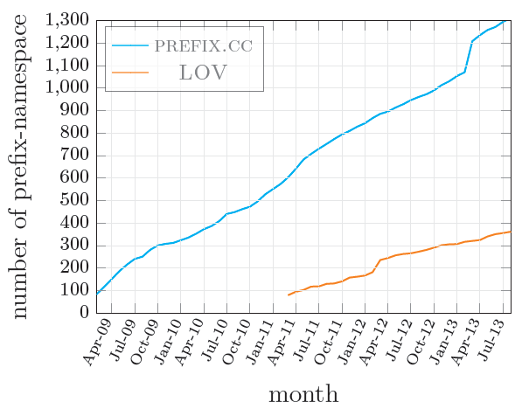
LOV vs PREFIX.CC-Alignment Findings
Category | Number
lov-able vocabs | 227
Intersect-prefixes | 188
vocabs in LOV | 321
vocabs in prefix.cc | 925
More than 200 prefixes in prefix.cc are vocabularies
2015/04/10

Slide 51
Vocabulary Search and Ranking
Goal
Ranking vocabularies based on Information Content Metrics
Metrics
Information Content Metric (IC): value of information associated with a given entity
Partition Information Content Metric (PIC)
Proposed a ranking based on IC and PIC
2015/04/10

Slide 52
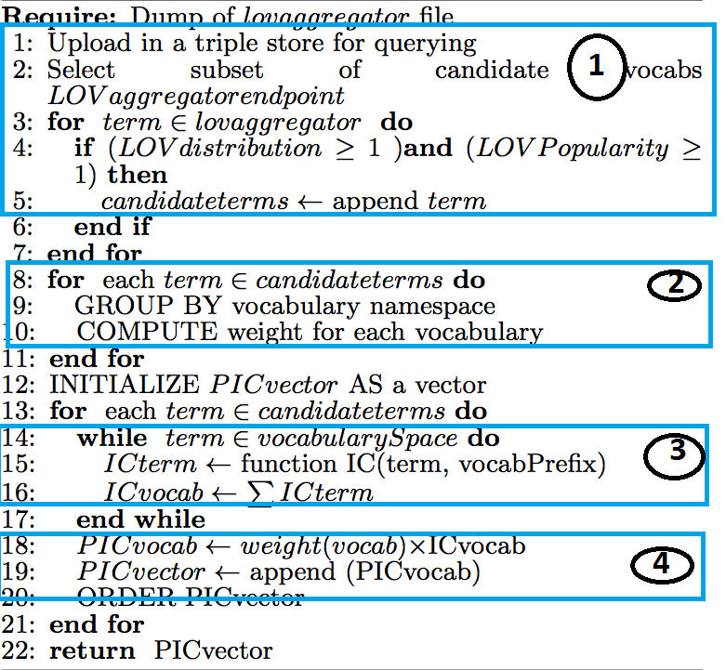
Ranking Algorithm
Candidate terms selection in LOV
Grouping terms by namespace & weight assignment
Compute IC score
Compute PIC score
Output ranking
2015/04/10
Notes:
+

Slide 53
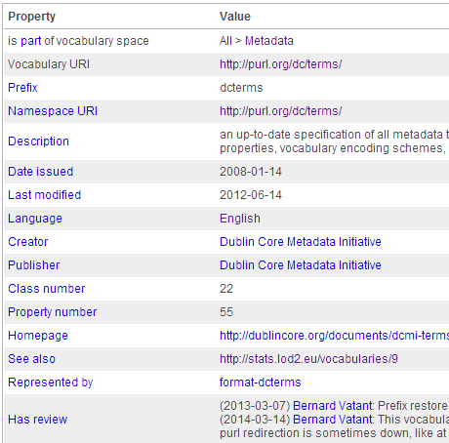
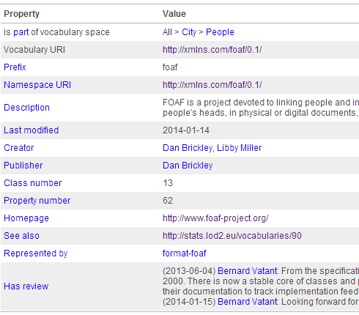
Ranking Algorithm
dcterms: http://purl.org/dc/terms/
Candidate terms: 53 (39 properties + 14 classes)
wf = 1+ 2+3 = 6
PIC = 1724.844
foaf: http://xmlns.com/foaf/0.1/
Candidate terms: 35 (26 properties + 9 classes)
wf = 1+ 2+ 3 = 6
PIC = 1033.197
PIC(dcterms) > PIC(foaf)
2015/04/10

Slide 54
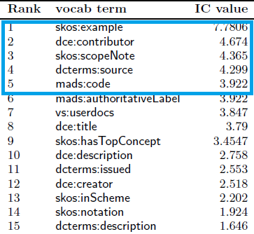
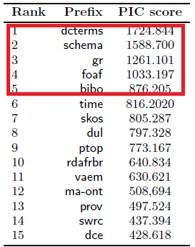
Ranking Algorithm
Top-15 terms (IC value)
Top-15 vocabs (PIC value)
2015/04/10

Slide 55
Applications of the Ranking Metrics
Vocabulary life-cycle management
Help assessing the use of terms and vocabulary updates
Monitoring the use of owl:deprecated or http://www.w3.org/2003/06/sw-vocab-status/ns#:term_status
Semantic Web applications
Vocabularies with higher PIC might be proposed to a user as much as possible, e.g. for choosing properties to display in a facetted browsing interface
Interlinking datasets
Generate sameAs links between resources based on vocabularies terms with lower IC value
2015/04/10

Slide 56
Licenses Compatibility
Goal
Reasoning on Licenses for checking compatibilities between vocabularies and datasets
Approach:
Licenses retrieval both for the dataset and for the vocabularies used in the dataset.
Deontic logic [1] to compute compatibility using RDF representation of licenses
[1] Governatori, Guido, et al. "One License to Compose Them All." The Semantic Web–ISWC 2013. Springer Berlin Heidelberg, 2013. 151-166.
2015/04/10
Notes:
+ Say here it is a joint work with INRIA and NICTA.
+ 16% of vocabularies in LOV contained license information in the metadata
+ Only 7.85% of data in LOD provide licensing information.

Slide 57
Our Proposal: LIVE Framework
http://www.eurecom.fr/~atemezin/licenseChecker/
2015/04/10

Slide 58
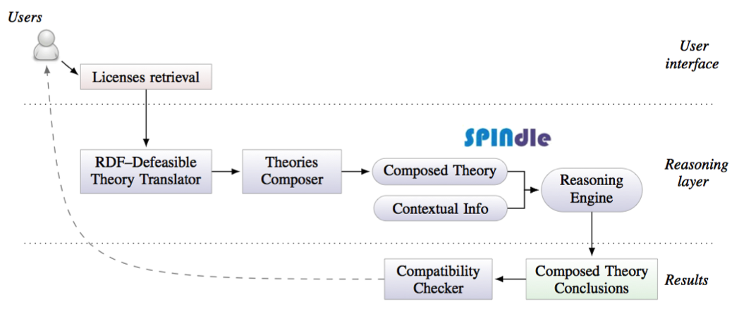
The Logic
RDF licenses: http://purl.org/NET/rdflicense
Logic of deontic rules:
constructive account of basic deontic modalities (obligation, prohibition, permission)
compute the set of all conclusions for each license and then check whether incompatible conclusions are obtained.
2015/04/10
Notes:
a,Ob ⇒l2 p: if a is the case and b is obligatory, then Op
holds in license l2.

Slide 59
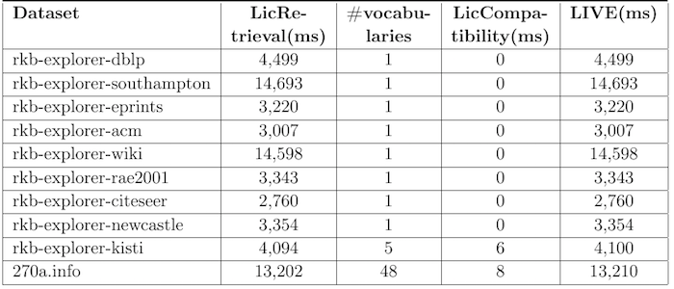
Live Evaluation
LIVE provides the compatibility in less than 5 seconds for 7 datasets
LIVE retrieves 48 vocabularies in less than 14 seconds
2015/04/10

Slide 60
Conclusions
We have presented models for Geodata
For better handling complex geometries
Supporting *all* CRS
For easy querying in SPARQL
We have proposed a generic visualization wizard
Based on predefined categories
Targeted to lay-users
We have contributed in managing vocabulary metadata
Disambiguating prefixes between vocabularies
Improving vocabulary search and ranking
Providing a license compatibility framework
Contributing to Best Practices standard
2015/04/10

Slide 61
Future Work
Managing Data updates and versioning
Versioning: integrate Memento protocol?
Spatio-temporal evolution
Multiple representation: need for metadata?
Level of detail
Geometry modeling rules and reasoning
Tracking Provenance of geodata
To ensure quality of published dataset
To ensure trust from application consumers
2015/04/10
Notes:
+ spend more time on them..

Slide 62
Future Work
Visualizations
Extend categories and vocabularies for detection
Provide templates for generating “mash-ups” to combine domains, an mash-up widget generator
Investigate the “importance” of a category in dataset
Provide a user evaluation
Metadata management
Publish a list of common recommended prefixes
Foster and support current effort towards a more sustainable governance of vocabularies.
Compare (P)IC with other graph-based ranking (e.g. pagerank)
Investigate the dependency ranking between vocabularies
2015/04/10

Slide 63
Publications
Pierre-Yves Vandenbussche, G.A. Atemezing, Maria Poveda, Bernard Vatant: Linked Open Vocabularies (LOV): a gateway to reusable semantic vocabularies on the Web. Semantic Web Journal, under review, 2015.
G.A. Atemezing, Raphael Troncy: Modeling visualization tools and applications on the Web. Semantic Web Journal, under review, 2015.
G.A. Atemezing et al.: Transforming meteorological data into linked data. In Semantic Web journal, Special Issue on Linked Dataset descriptions, 2012. IOS Press.
Guido Governatori, Ho-Pun Lam, Antonino Rotolo, Serena Villata, G.A. Atemezing and Fabien Gandon: LIVE: a Tool for Checking Licenses Compatibility between Vocabularies and Data.(ISWC 2014, Demo Track)
G.A. Atemezing and Raphael Troncy: Information content based ranking metric for linked open vocabularies. (SEMANTICS 2014)
Ahmad Assaf, G.A. Atemezing, Raphael Troncy and Elena Cabrio: What are the important properties of an entity? Comparing users and knowledge graph point of view. In 11th Extended Semantic Web Conference (Demo Track, ESWC 2014)
2015/04/10
Notes:
+ number the item either of

Slide 64
Publications
Francois Scharffe, G.A Atemezing, Raphael Troncy, Fabien Gandon, Serena Villata, Bénédicte Bucher, Faycal Hamdi, Laurent Bihanic, Gabriel Kepeklian, Franck Cotton, Jerome Euzenat, Zhengjie Fan, Pierre-Yves Vandenbussche and Bernard Vatant: Enabling linked-data publication with the datalift platform. (AAAI, W10:Semantic Cities, 2012)
G.A. Atemezing and Raphael Troncy: Vers une meilleure interopérabilité des donneés geographiques francaises sur le Web de donneés. (IC 2012).
Houda Khrouf, G.A. Atemezing, Thomas Steiner, Giuseppe Rizzo and Raphael Troncy: Confomaton: A conference enhancer with social media from the cloud. (ESWC 2012, Demo Track)
Bernadette Hyland, G.A. Atemezing and Boris Villazón-Terrazas (editors): Best Practices for Publishing Linked Data. W3C Working Group Note pub- lished on January 9, 2014. URL: http://www.w3.org/TR/ld-bp/
Bernadette Hyland, G.A Atemezing, Michael Pendleton, Biplav Srivastava (editors): Linked Data Glossary. W3C Working Group Note published on June 27, 2013. URL: www.w3.org/TR/ld-glossary/
2015/04/10

Slide 65
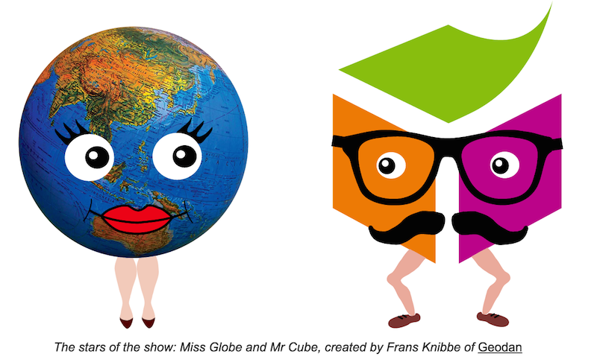

Thank you for your attention!
Credits layout
Mariella Sabatino: mll.sabatino@gmail.com
Notes:
Mrs. Globe and Mr. Cube

